Slide 1

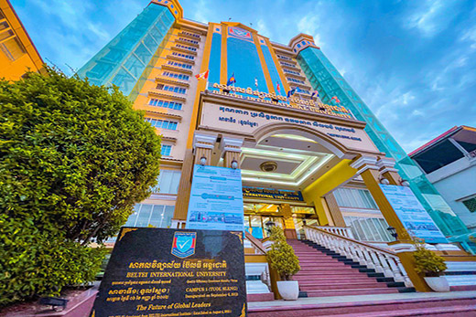
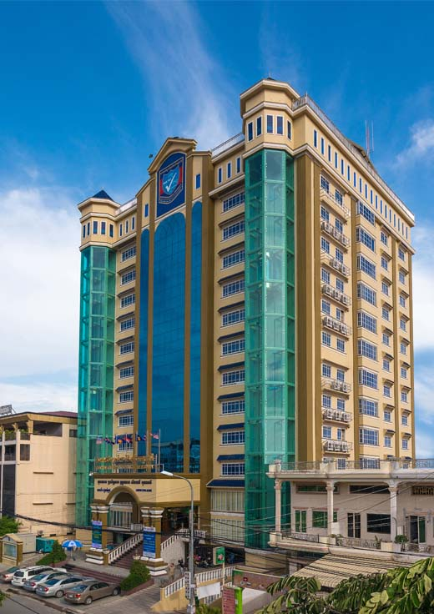
មហាវិទ្យាល័យព័ត៌មានវិទ្យា និង វិទ្យាសាស្ត
Faculty of Information Technology and Science
3
Major: Software Engineering
subject: Python Year 4, Semester 2
Topic: Creating a website for Ai image generators using Front-end react Js and Backend python
Lecturer: Cheng Sovann

Slide 2
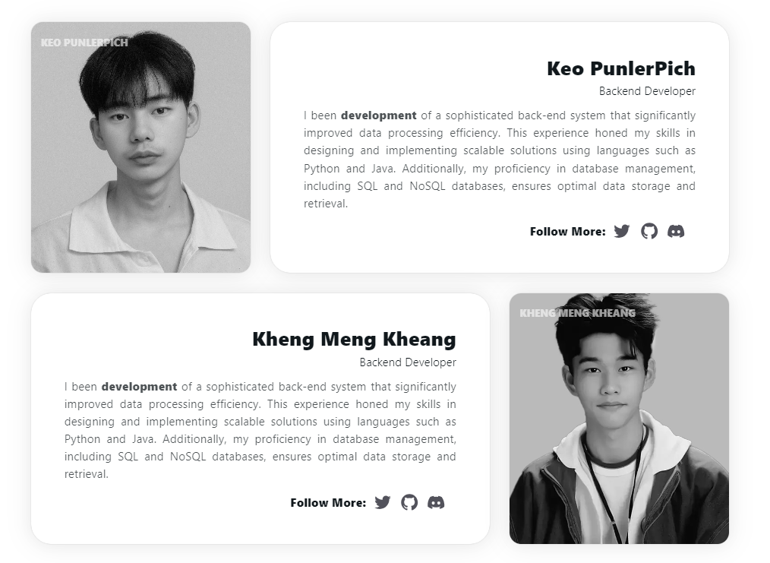
TEAM

Slide 3
TECHNOLOGY

Slide 4


django

Slide 5
PROJECT SET UP

Slide 6
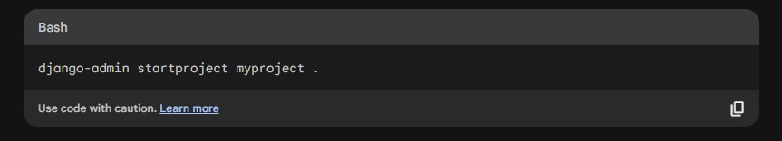
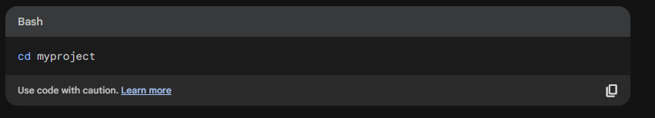
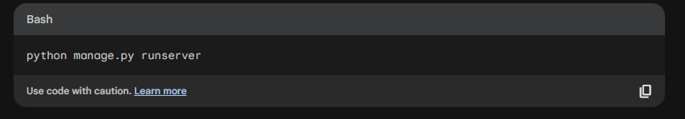
CREATE DJANGO PROJECT

Slide 7
CREATE REACT PROJECT

Slide 8
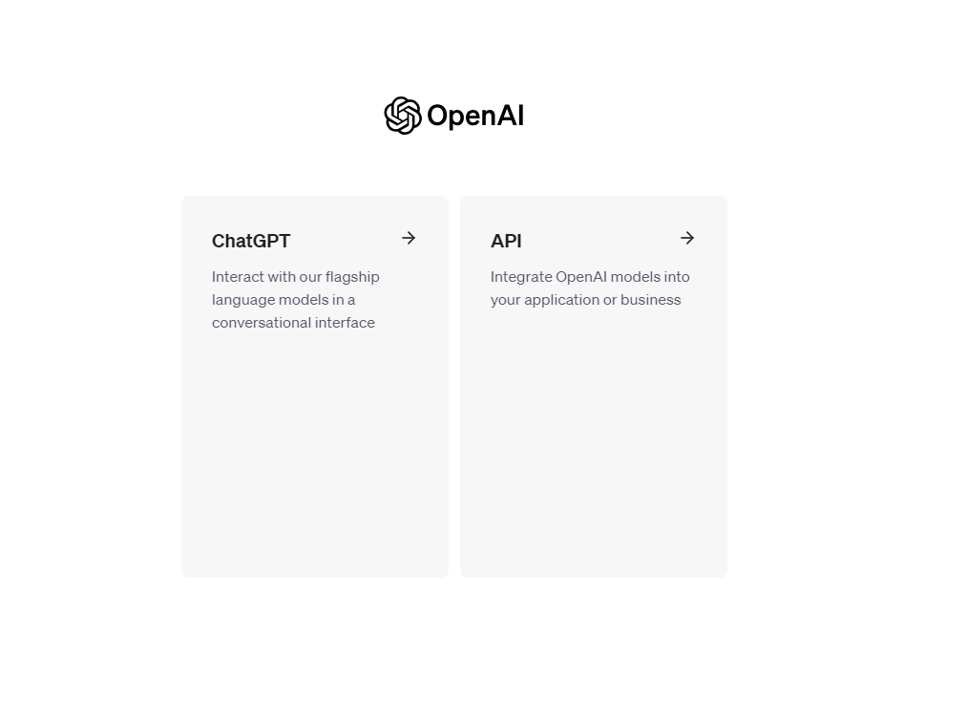
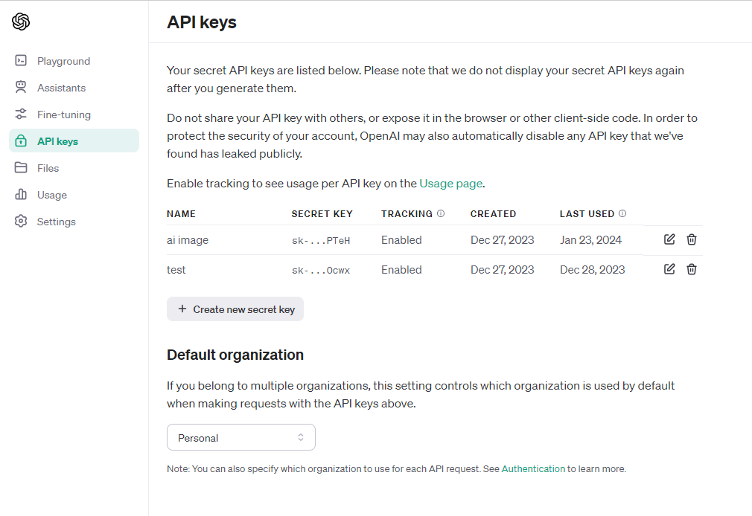
OPEN AI API KEY

Slide 9
PROJECT DEVELOP

Slide 10
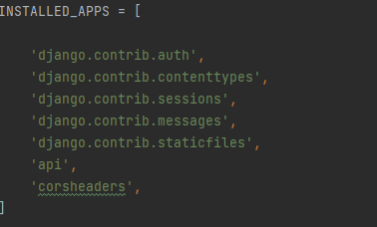
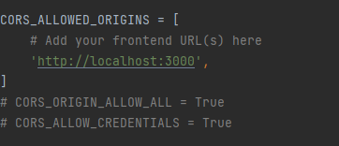
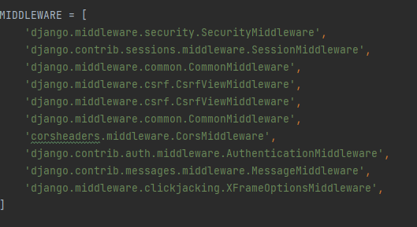
SETTING DJANGO PROJECT

Slide 11
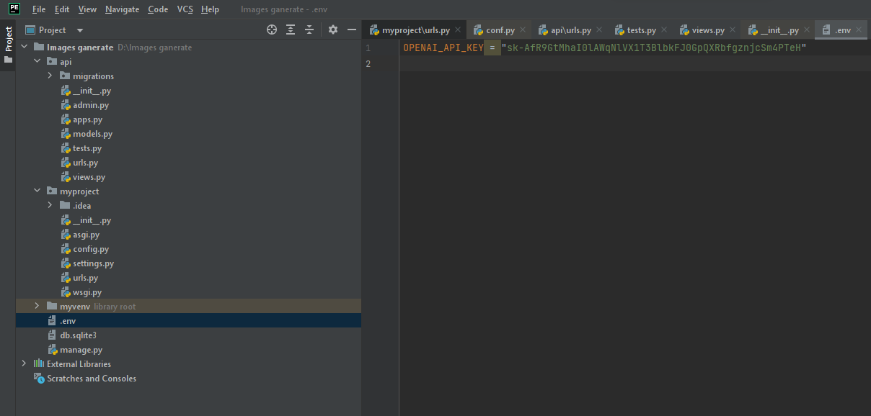
CREATE FILE STORE API KEY

Slide 12
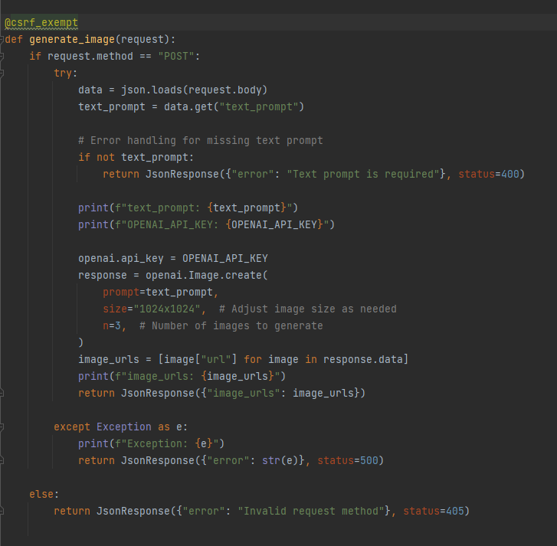
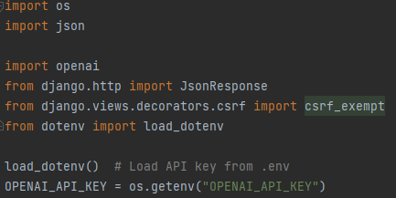
VIEW BACKEND

Slide 13
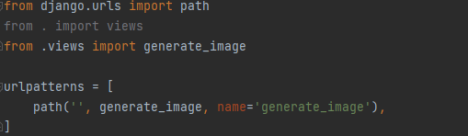
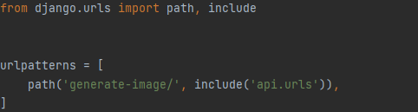
URLS CODE

Slide 14
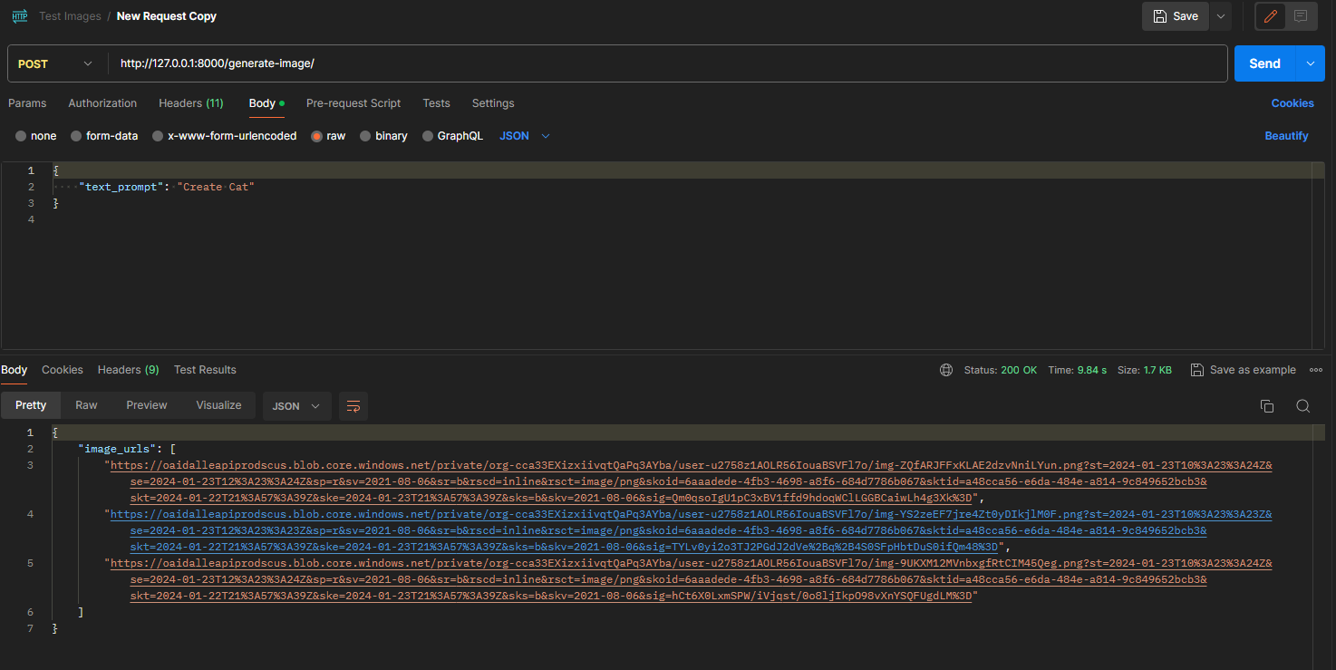
TESTING ON POSTMAN

Slide 15
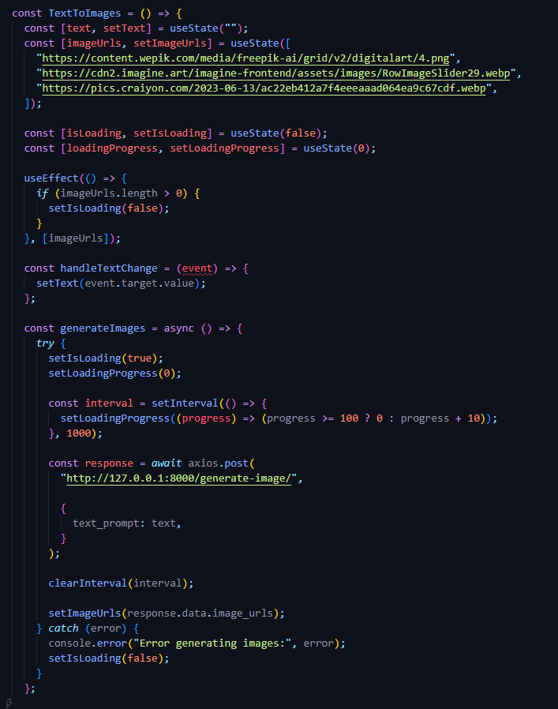
FRONTEND CODE

Slide 16
PROJECT DEMO

Slide 17
Link to demo project

Slide 18

Any question?

